Slide 1

Databases Administration and Security (SEC2203)
Dr. Hatim Alsuwat
Introduction Lecture

Slide 2
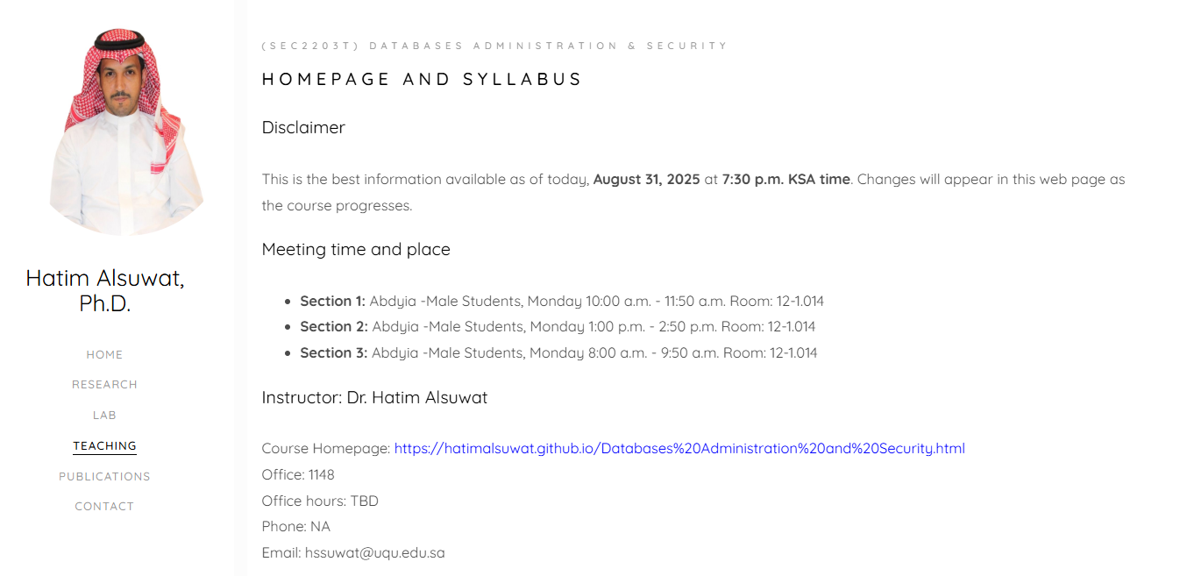
Course Information
https://hatimalsuwat.github.io/Databases%20Administration%20and%20Security%202026.html
Communication:
Announcements on webpage/ emails/ blackboard
Questions? Email me.
Staff email: hssuwat@uqu.edu.sa
Course technology:
Website
UQU Blackboard
Regular homework
Help us make it awesome!

Slide 3
Course Information
Course Website
https://hatimalsuwat.github.io/Databases%20Administration%20and%20Security.html
Discussion:
Please ask any question during the lecture (don’t be shy)
There is no such thing as a stupid question.
Answer others’ questions - if you know the answer ;-)
Learn from others’ questions and answers

Slide 4
Course Information
Meeting time and place:
Office: Department of Computer Science (office #1148)
Office hours: Please email me if you have any question. If necessary, I will arrange a phone call or a virtual meeting
Email: Hssuwat@uqu.edu.sa

Slide 5
Learning Resources
Required Textbooks:
Fundamentals of Database Systems, 7th edition Published by Pearson (July 14, 2021) © 2016, Ramez Elmasri, Shamkant B. Navathe

Slide 6
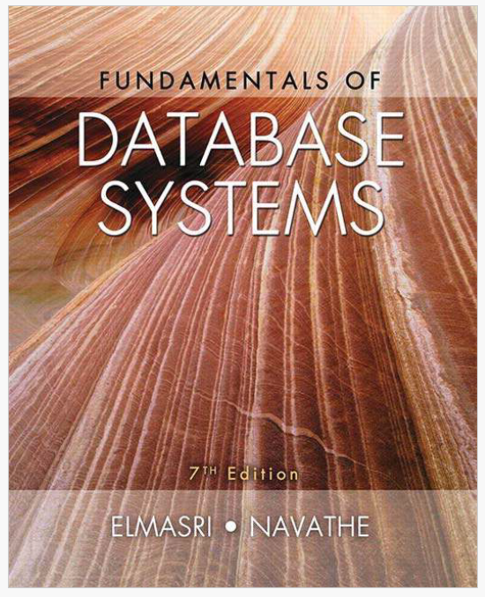
Textbook

Slide 7
Course Description
This course introduces the fundamental concepts necessary for designing, using, and implementing database systems and database applications.
It includes relational (structured) databases, SQL, and non-structured databases such as NoSQL.
Then, the course continues with database security, which includes a discussion of SQL commands for discretionary access control (DAC), as well as mandatory security levels and models for including MAC in relational databases
Also, this course discuss threats such as SQL injection attacks, as well as other techniques and methods related to data security and privacy.

Slide 8
Course Content
# | Topic | Contact Hours
1 | Introduction to Databases and Users | 2
2 | Database System Concepts & Architecture | 2
3 | ER Data Modeling | 4
4 | Relational Model & Constraints | 4
5 | SQL (DDL/DML, Queries & Transactions) | 4
6 | Security Threats & Vulnerabilities (Inference, Aggregation, SQL Injection, Corruption, Unauthorized Access) | 4
7 | Access Control Models & Flow Control (DAC, MAC, RBAC, Clark-Wilson; Flow Control) | 4
8 | Cryptography & Privacy (Hashing, Encryption, Privacy Issues & Preservation) | 3
9 | Object-based & Distributed; NoSQL & Big Data | 3

Slide 9
Assessment Tasks for Students
# | Assessment task* | Week Due | Percentage of Total Assessment Score
1 | Project | W 15 | 20
2 | Lab assessments | Weekly | 20
6 | Mid-term Exam | W 8 | 20
8 | Final Exam | W 18 | 40
Total score that can be achieved: 100

Slide 10
Course Information: Feedback
Please give feedback positive or negative as early as you can via email.

